Slide 1
CourseNet
Presented by Emmanuelle, Jeffrey, Wen, Zi, and Kenny
October 30th, 2024

Slide 2
01
The Idea

Slide 3

Course Enrollment Scheduler
Digital application designed to simplify the process of course enrollment for students.
Students should be able to browse and enroll for available courses based off their majors.
Teachers are able to view their roster of students and remove students.
This is a simple app that allows students to organize schedules and connect students to their courses.

Slide 4
02
Why Invest?

Slide 5

Investment Opportunities
Targeted in-app ads for educational products/services create an additional revenue stream.
The app provides data on course trends, user engagement, and scheduling preferences, offering valuable insights for targeted advertising and strategic growth.
Future opportunity to introduce premium subscription plans for institutions and users, offering enhanced features and generating steady, recurring revenue.
Beyond course enrollment, the app could eventually expand to offer other educational services such as tutoring scheduling.

Slide 6
03
User Flow

Slide 7

Functional Use Cases
Student
The student can search for course based on major, view their schedule, enroll in a course, and receive any announcements for the course
Teacher
Teachers are able to view a list of courses they’re teaching and the roster of students associated with the course. Can upload announcements and remove students.

Slide 8
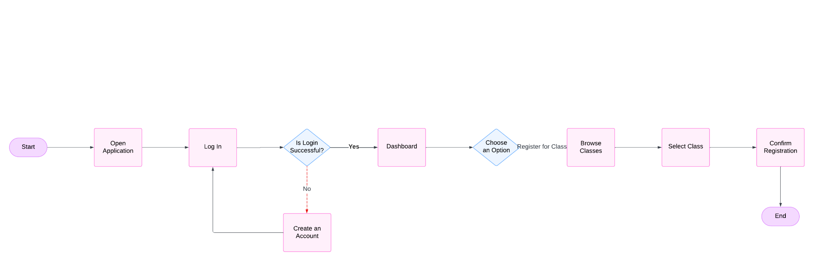
User Journey Map (Student)

Slide 9
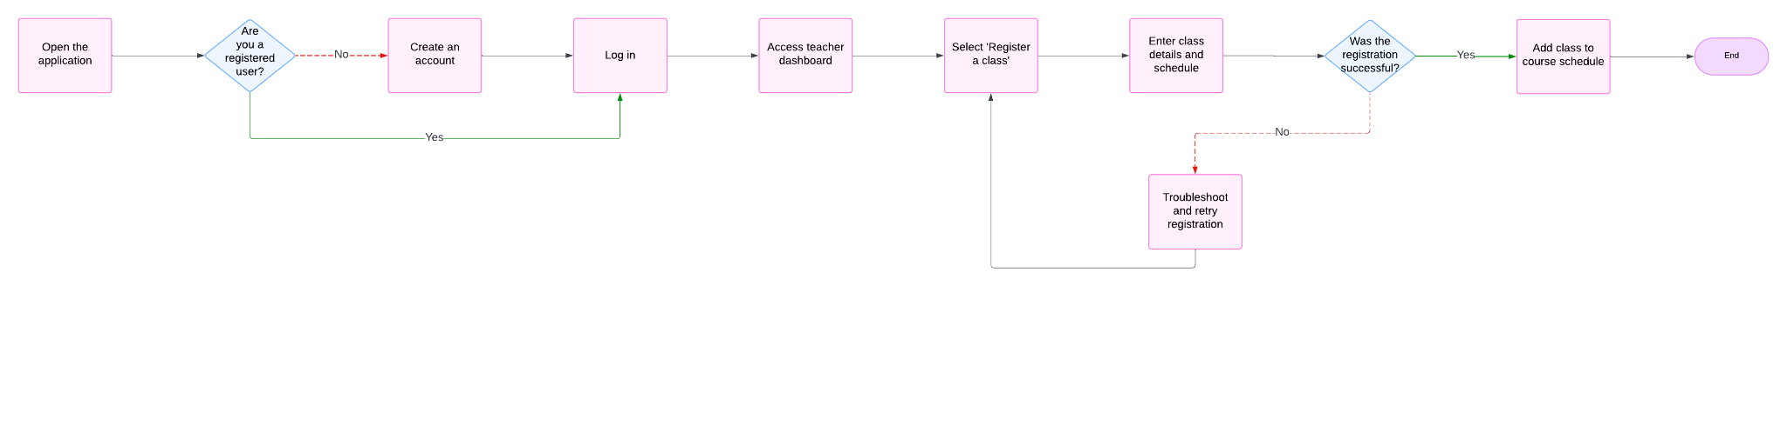
User Journey Map (Teacher)

Slide 10
04
Data Modeling

Slide 11
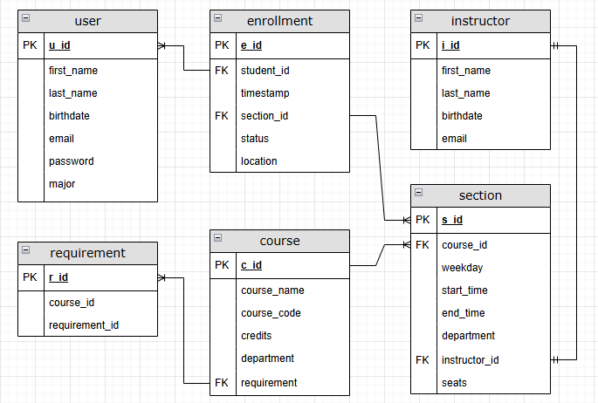
ER Diagram

Slide 12
05
Possible Added Functionality

Slide 13
Tutoring Appointment Scheduler
Tutoring scheduler is designed to simplify and streamline the process of scheduling tutoring appointments between students and teachers.
Students can browse available tutors and schedule sessions at their convenience.
Tutors can set their availability and manage appointments.
The app reduces administrative hassle making it easier to organize schedules and communicate with students.
In addition to the course enrollment scheduler, the app will also allow student to set up tutoring for their respective courses.

Slide 14
06
Tech Stack

Slide 15




DBMS
Backend
Frontend
MySQL
Node.js
React
Business Intelligence
PowerBI

Slide 16
07
Roles

Slide 17
Member Roles
Emmanuelle Padilla (Front End Development)
Wen Jie Long (Front End Development)
Jeffrey Umanzor (Back end Development)
Kenny Zhu (Back end Development)
Zi Xuan Li (Front End Development)

Slide 18
Thank You!
Questions?

